Slide 1

POLYMER EDUCATION IN VIETNAM
Ngo Trinh Tung
Institute of Chemistry – Vietnam Academy of Science and Technology (VAST)

Slide 2
OUTLINE OF PRESENTATION
Introduction about High Education in Vietnam
Polymer Education in Vietnam
Polymer Education at VAST
Conclusions

Slide 3
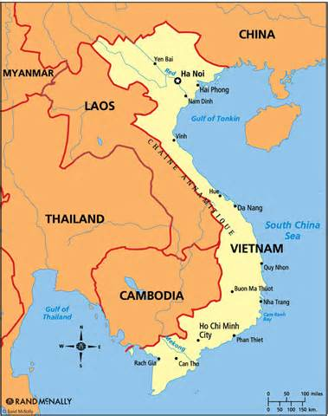
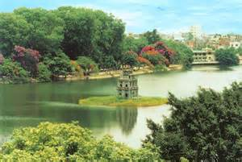


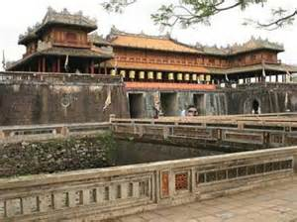
1. INTRODUCTION ABOUT HIGH EDUCATION IN VIETNAM
Location: Southeast Asia
Capital: Hanoi City
Area: 329.560 sq km
Population: 90 mil.
GDP per capita: 1,800 USD
Hanoi
HCM City
Halong Bay
Hue

Slide 4
OVERVIEW ABOUT HIGH EDUCATION IN VIETNAM
Development of universities number in the last decade in Vietnam
Report of Ministry of Education and Training in 2012

Slide 5
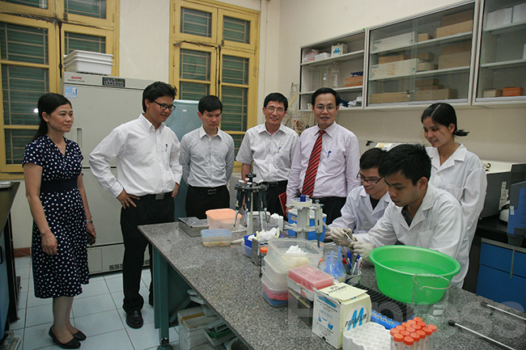
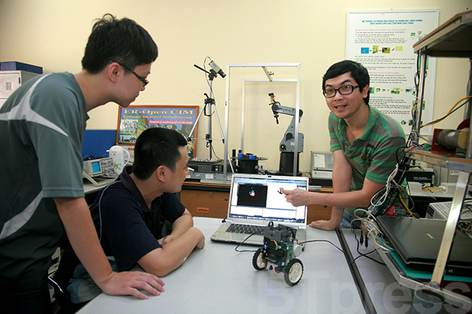

Slide 6




MAIN UNIVERSITIES IN VIETNAM
Vietnam National University Hanoi
Total students: 32.140
110 academic programs for undergraduate students
168 academic programs for master students
137 academic program for Ph.D. students
Vietnam National University Hochiminh
Total students: 51.422
120 academic programs for undergraduate students
88 academic programs for master students
90 academic program for Ph.D. students
Total students: 30.000
25 academic programs for undergraduate students
60 academic programs for master students
53 academic program for Ph.D. students
University of
Danang
Total students: 35.000
28 academic programs for undergraduate students
66 academic programs for master students
57 academic program for Ph.D. students
Hanoi University of
Science and Technology

Slide 7

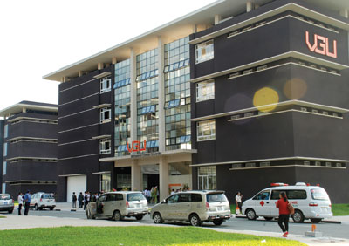
JOINT UNIVERSITIES IN VIETNAM
Vietnamese – German University (VGU): founded in 2008 with 750 students (2013)
University of Science and Technology Hanoi (USTH) supported from France: founded in 2009 with 420 students
Planning Joint University with USA, England, Japan

Slide 8
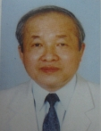
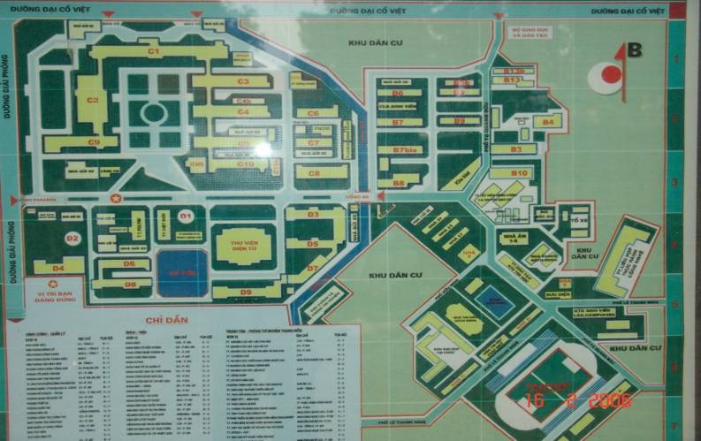
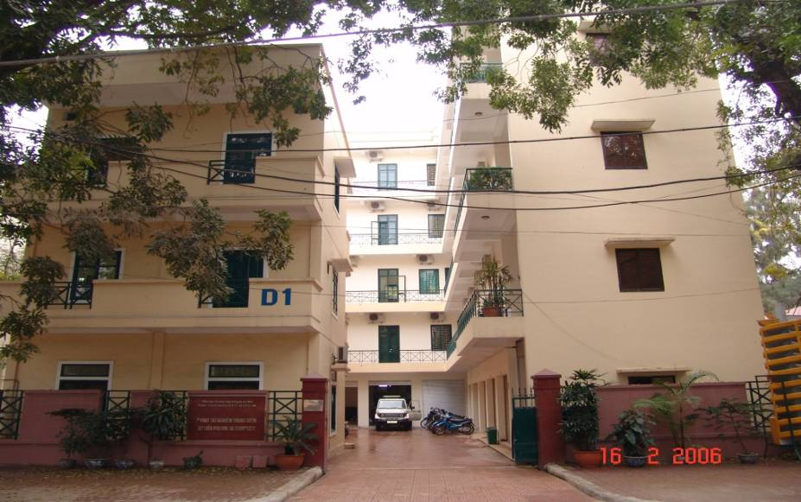
2. POLYMER EDUCATION IN VIETNAM
POLYMER CENTER – HANOI UNIVERSITY OF
SCIENCE AND TECHNOLOGY
Prof. Tran Vinh Dieu
Founded in 1978,
Director: Dr. Nguyen Thanh Liem
Staffs of Polymer Center:
- 02 Professors
06 PhD
07 Master
06 Engineers
09 scientific workers

Slide 9
PROFESSIONAL ORGANIZATION
Director
Vice directors
Administration
Finance Department
Committee for Science and Technology
Lab. for Polymer Chemistry
Lab. For Physico- chemical Analyses
Lab. for Testing Physico-mechanical, Electric and Fire -resistant properties of Plastics, Rubbers and Polymer Composites
Lab. For Testing Physico-mechanical, Anti-corrosive Properties and Weather Resistance of Coatings

Slide 10
TEACHING ACTIVITIES
Around 45 - 50 engineers have been trained by the Polymer Centre annually.
In the period from 1995 to 2011 the Polymer Center trained 15 PhDs, 75 masters.
The Polymer Center also has provided teaching courses to improve professional skills of engineers and workers from the companies.

Slide 11
RESEARCH ACTIVITIES
Organic surface coating, including special coating for food containers, chemically resistant coating
Structural adhesives such as high performance structural adhesive, durable adhesive system for rubber – metal bond
Polymer composites based on natural fiber and other nano-filler
Rubber and rubber blends materials

Slide 12
NATIONAL RESEARCH PROJECTS IMPLEMENTED AT THE POLYMER CENTER
2003 - 2005: Investigating polymer composite materials based on polypropylene reinforced by bamboo fiber and nano clay for household and industrial applications .
2006 - 2008: Investigation and development short bamboo fibers and bamboo mat for Green composites.
2008-2010 Vietnam – Belgium join project on natural fibers research stage 1
2009-2011 Vietnam – Belgium join project on natural fibers research stage 2
2011-2013 Research and development green composite reinforced by MFC
2013-2015 Research and development composite material technology for
automobile industries

Slide 13
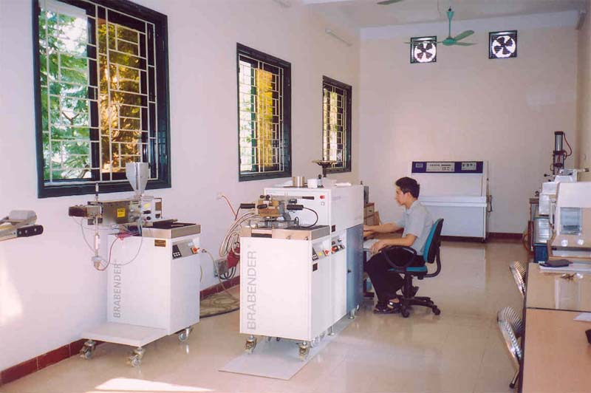
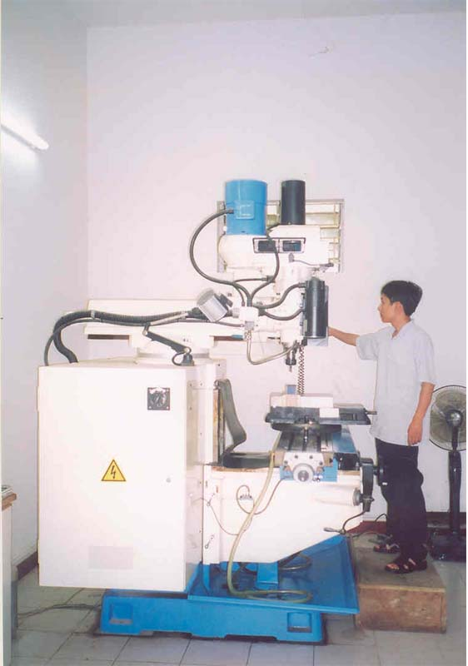
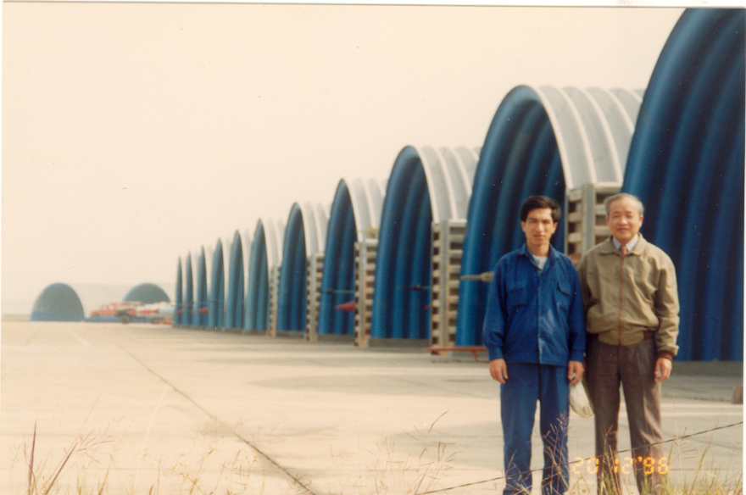
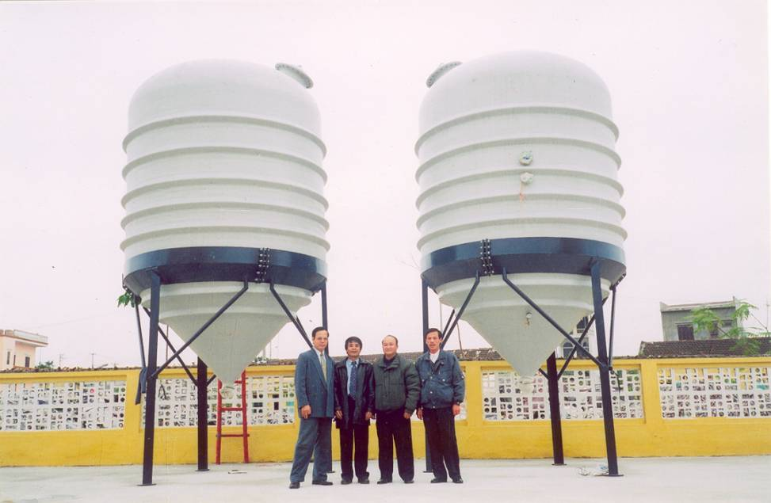
RESEARCH FACILITIES AND APPLICATION AT POLYMER CENTER

Slide 14

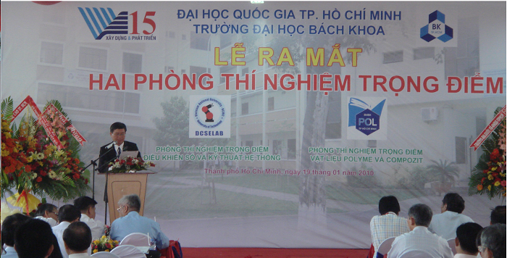
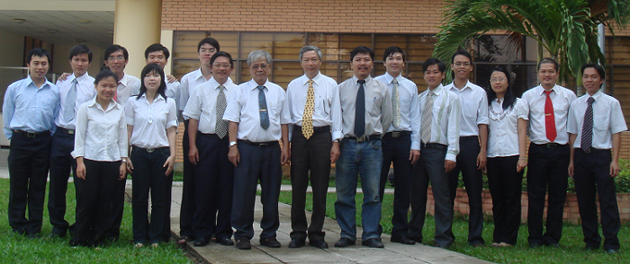
Polymer Education at The National Key Laboratory for Polymers and Composite - Faculty of Materials Technology, Vietnam National University HCM
Establishment in 2003
Head of Lab : Prof. Nguyen Dac Thanh
Staffs of LAB:
- 03 Professors
- 04 PhD
- 04 Master.
Prof. Nguyen Huu Nieu

Slide 15
EDUCATION AND RESEARCH ACTIVITIES AT THE NATIONAL KEY LAB FOR POLYMER AND COMPOSITES
Training about 80 undergraduate students annually
Training about 8-10 master and PhD students annually
Main research fields:
- Advanced Polymer Materials
- Bio-degradable Polymers
- Polymer Nanocomposite
- Rubber and Rubber Blends Materials

Slide 16
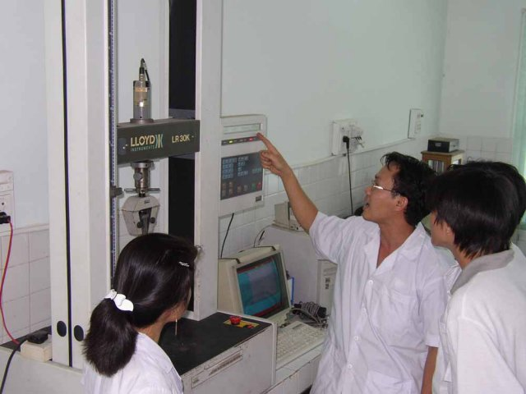

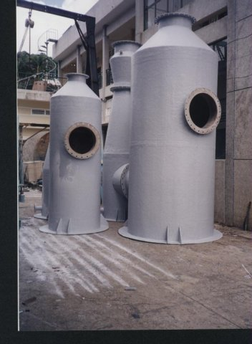
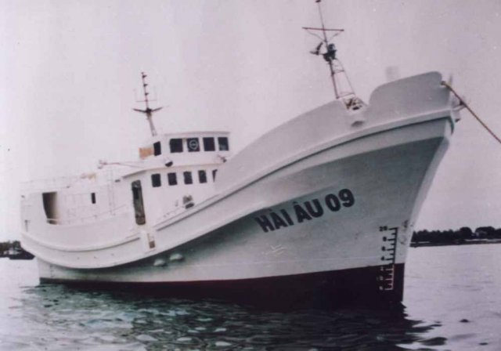
RESEARCH FACILITIES AND APPLICATIONS FROM THE NATIONAL KEY LAB FOR POLYMER AND COMPOSITES AT VNU-HCM

Slide 17
POLYMER EDUCATION AT OTHER UNIVERSITIES IN VIETNAM
Faculty of Chemistry, University of Science – Vietnam National University Hanoi
Faculty of Chemistry, University of Science – Vietnam National University Hochiminh
Faculty of Chemistry, University of Danang
Faculty of Chemistry, Hue University

Slide 18

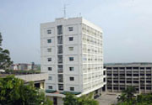
3.POLYMER EDUCATION AT VIETNAM ACADEMY OF SCIENCE AND TECHNOLOGY (VAST)
The Institute of Chemistry
The institute of chemistry was founded in 1978 with 5 research divisions:
The Division of Polymer Science and Technology
The Division of Bio-Organic Chemistry
The Division of Analytical Chemistry
The Division of Inorganic Physico-Chemistry
The Division of Environmental Chemistry
Academic program for master and Ph.D. students:
150 master and 100 PhD student have graduated at the institute of chemistry
30 master and 100 PhD students have been trained at the institute of chemistry

Slide 19
DIVISION OF POLYMER SCIENCE AND TECHNOLOGY
Department of Polymer Materials
Head of Department: Prof. Nguyen Van Khoi
Staffs: 01 professor, 06 Ph.D, 07 Msc. and 05 researchers
Main research fields:
- Super-absorbent polymer materials
- Polymer for agricultural Applications such as UV-absorption polymer film
Educational activities:
- Training PhD students: 09 graduated, 04 ongoing
- Training master students: 20 graduated, 04 ongoing
- Supervision 70 Diploma thesis

Slide 20
DIVISION OF POLYMER SCIENCE AND TECHNOLOGY
Department of Functional Polymers and Nanomaterials
Head of Department: Assoc. Prof. Ngo Trinh Tung
Staffs: 02 professors, 02 PhD, 01 Msc. and 05 researchers
Main research fields:
- Functional Polymers such as conducting polymers and its
application for organic solar cells, light emitting diode, field effect transistor,
- Biodegradable polymer ( PLA)
- Nanomaterials and polymer nanocomposite
Educational activities:
- Training PhD students: 05 graduated, 03 ongoing
- Training master students: 10 graduated, 02 ongoing
- Supervision 40 Diploma thesis

Slide 21
DIVISION OF POLYMER SCIENCE AND TECHNOLOGY
Department of Natural Polymers
Head of Department: Assoc. Prof. Do Truong Thien
Staffs: 01 professor, 02 PhD, 01 Msc. and 03 researchers
Main research fields:
- Natural polymers such as chitin/chitosan, glucomannan, alginate
- Modification of natural polymers for bio-medical application
- Polymer nanocomposite based on natural polymer
Education activities:
- Training PhD students: 10 graduated, 03 ongoing
- Training master students: 12 graduated, 03 ongoing
- Supervision 50 Diploma thesis

Slide 22
DIVISION OF POLYMER SCIENCE AND TECHNOLOGY
Department of Polymer Technology
Head of Department: Assoc. Prof. Do Quang Khang
Staffs: 01 professor, 03 Msc. and 02 researchers
Main research fields: rubber and rubber blends, rubber nanocomposites
Educational activities:
- Training PhD students: 02 graduated, 04 ongoing
- Training master student: 04 graduated, 02 ongoing
- Supervision 50 Diploma thesis

Slide 23
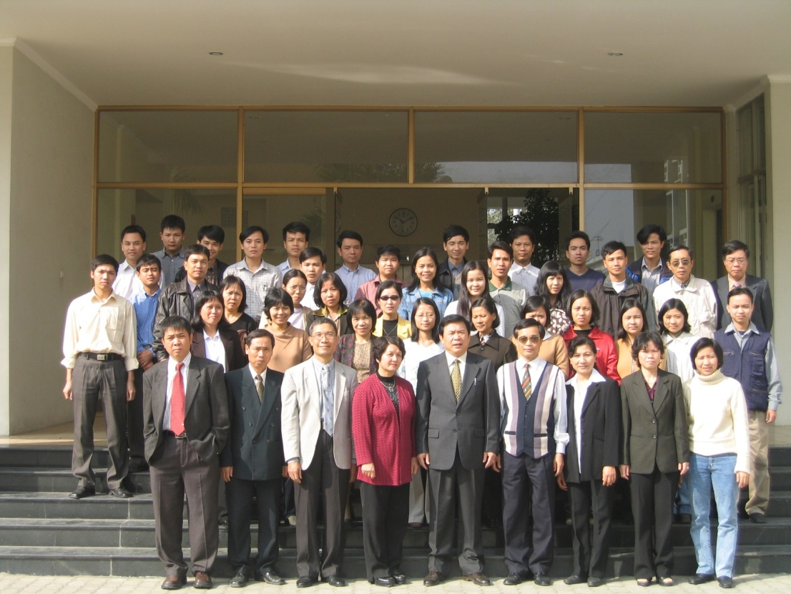
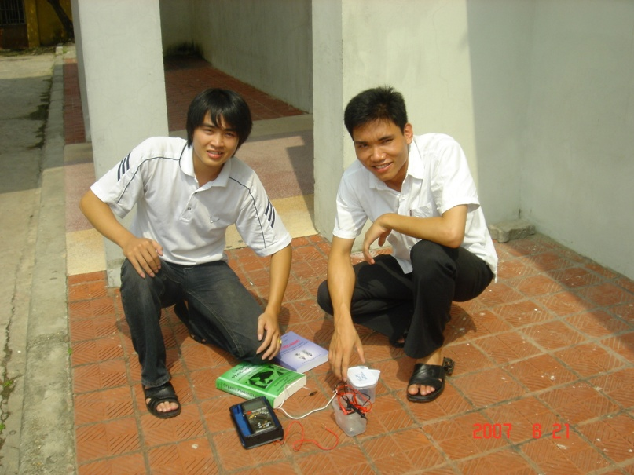
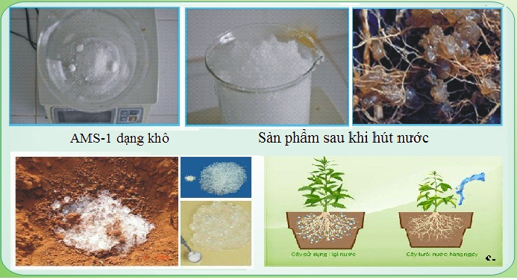
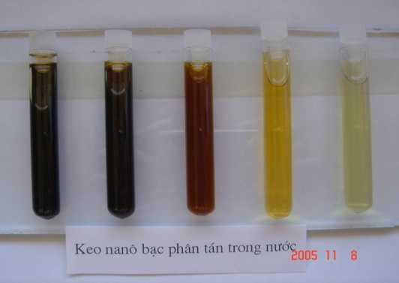
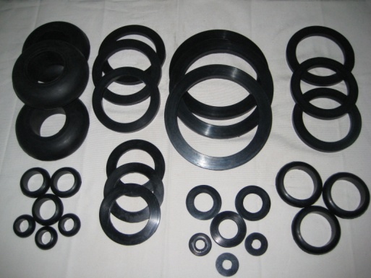
DIVISION OF POLYMER SCIENCE AND TECHNOLOGY

Slide 24
POLYMER EDUCATION AT OTHER INSTITUTE OF VAST
The Institute for Tropical Technology:
- Department of Rubber and Natural Resins - Department of Protective Coating
- Department of Physico-Chemical Non-Metallic Materials
The Institute of Materials Science:
- Department of Polymer Composites

Slide 25
4. CONCLUSIONS
There are many polymer education program for both under-graduate and graduate students at universities and research institutes, mainly at the Polymer Center (Hanoi University of Science and Technology), The National Key Laboratory for Polymer and Composite ( Vietnam National University HCM) and the Institute of Chemistry, VAST
The number of students in the field of polymer science and technology in Vietnam is relative low compared to other academic disciplines
The polymer education in Vietnam is still facing the challenges to improve the research ability and research capacity

Slide 26
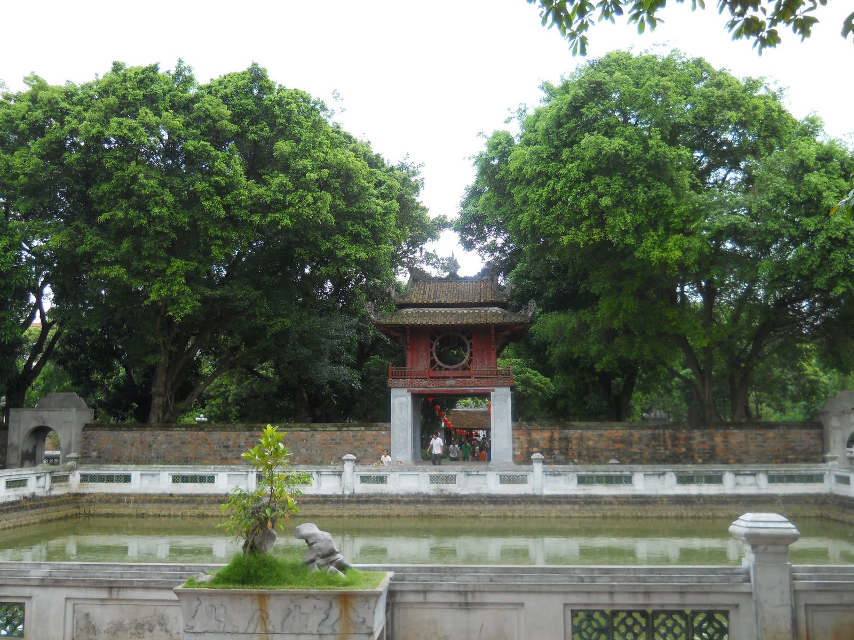
THANK YOU FOR YOUR ATTENTIONS

